Slide 1
In Situ Burning
CGPRT(W) : Ensuring Clean Seas and Coasts in Western Region ……

Slide 2
Aim
Understand the operational aspects of in situ burning including support equipment and accessories required.
CGPRT(W) : Ensuring Clean Seas and Coasts in Western Region ……

Slide 3
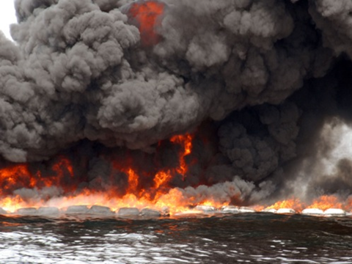
In Situ Burning − ISB
CGPRT(W) : Ensuring Clean Seas and Coasts in Western Region ……

Slide 4
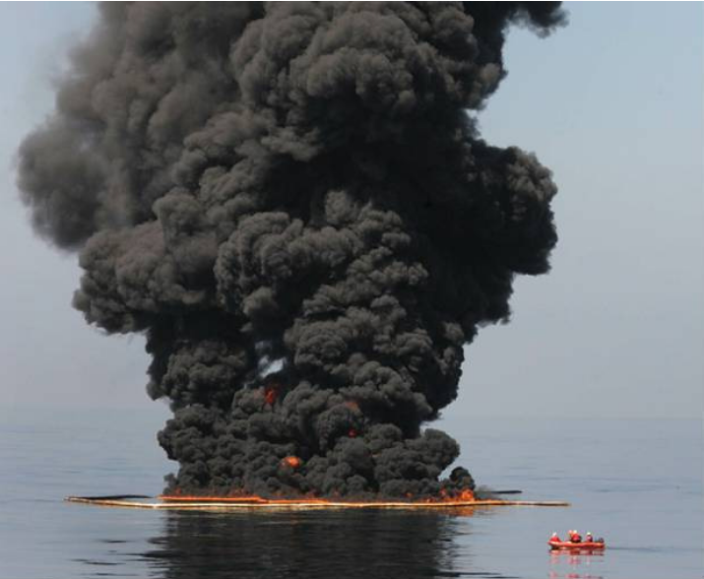
Deepwater Horizon
Source: USCG
CGPRT(W) : Ensuring Clean Seas and Coasts in Western Region ……

Slide 5
In Situ Burning − ISB
The principle is to combust vapours from slicks on a water or land surface.
It has been used on small inland and onshore spills in North America since the late 1950s.
CGPRT(W) : Ensuring Clean Seas and Coasts in Western Region ……

Slide 6
In Situ Burning − ISB
ISB operations can be conducted on land, ice or other hard surfaces, or on water.
Like any response technique the effectiveness, efficiency and success rates are dependent on:
  The type and properties of the oil
  The amount of weathering that has occurred
  The amount of oil and area covered
  The response time and equipment availability
  The current and forecasted weather and sea state.
CGPRT(W) : Ensuring Clean Seas and Coasts in Western Region ……

Slide 7
In Situ Burning Operations
All ISB operations require:
  Sufficient fuel to generate an ignitable concentration of vapours (the vapour burns rather than the liquid).
  An ignition source to instigate the burn.
  Sufficient quantities of fuel (i.e. at least 2−3mm oil thickness) to sustain a burn.
  Herding agents, if allowed, may be considered to increase the oil thickness.
  Specialist training.
  Means of measuring the air and water quality.
CGPRT(W) : Ensuring Clean Seas and Coasts in Western Region ……

Slide 8
Equipment Required
Offshore:
  Boom towing vessels
  Fire boom
  Igniter
  Fire control
  Air quality monitoring and Wind and Sea state monitoring
  Aerial surveillance
  Personal protective equipment (PPE)
  Burn residue recovery resources
CGPRT(W) : Ensuring Clean Seas and Coasts in Western Region ……

Slide 9
Equipment Required
Onshore:
  Trenching equipment or shovels to provide a collection basin
  Igniter
  Fire control
  Air quality monitoring
  Wind direction monitoring
  Personal protective equipment (PPE)
CGPRT(W) : Ensuring Clean Seas and Coasts in Western Region ……

Slide 10
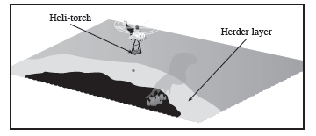
Helicopter Herder
Source: ExxonMobil
CGPRT(W) : Ensuring Clean Seas and Coasts in Western Region ……

Slide 11
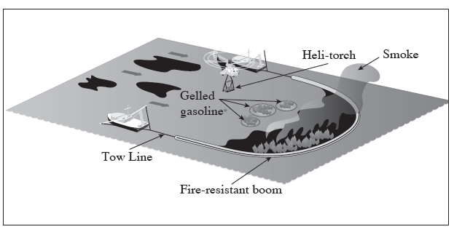
Typical ISB Operation on Water
Source: ExxonMobil
CGPRT(W) : Ensuring Clean Seas and Coasts in Western Region ……

Slide 12
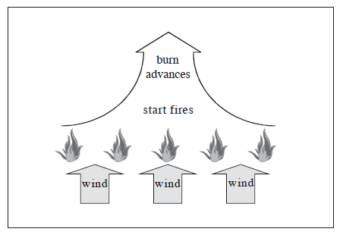
Initiating an in Situ Burn
Source: ExxonMobil
CGPRT(W) : Ensuring Clean Seas and Coasts in Western Region ……

Slide 13
ISB Fire Boom Configurations
Boom
“U” with feather line or bridle
Tow and feather line
Standard “U”
Towing vessel
Wind direction
3-tow vessel “U” with feather line or bridle
Feather line or bridle at boat
Oil slick
CGPRT(W) : Ensuring Clean Seas and Coasts in Western Region ……

Slide 14
Fire Boom
Fire boom can be classified as either:
  Actively-cooled fire-resistant boom
    Resistance to heat is achieved by pumping water onto the surface of the boom or by wicking water into the boom surface material.
  Intrinsically fire-resistant boom
    Resistance to heat is achieved through the use of fire-resistant materials in its construction.
CGPRT(W) : Ensuring Clean Seas and Coasts in Western Region ……

Slide 15
Fire Boom
They have a finite life once deployed as integrity will be reduced through repeated burns.
Important that:
  it will last through the proposed burn operation;
  that the boom can contain the fire residues;
  that the boom will remain sufficiently intact so that it can be recovered for disposal.
Generally heavier than conventional boom so more prone to failure in higher sea conditions.
CGPRT(W) : Ensuring Clean Seas and Coasts in Western Region ……

Slide 16
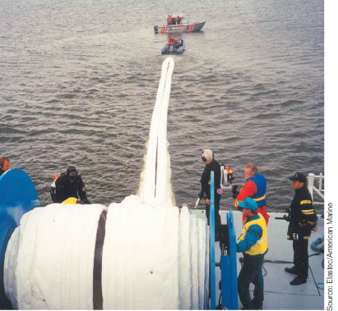
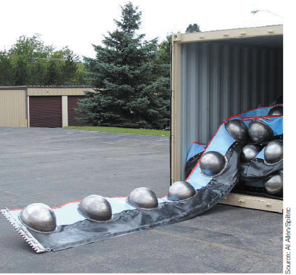
Typical Fire Booms
CGPRT(W) : Ensuring Clean Seas and Coasts in Western Region ……

Slide 17
Actively Cooled Fire Boom
Cooling system that uses water pumps and a protective jacket.
Distributes water across the exposed surfaces to provide cooling.
Can be stored on powered reel.
Needs specific training due to ancillary equipment
  Reel, air pumps, water pumps.
CGPRT(W) : Ensuring Clean Seas and Coasts in Western Region ……

Slide 18
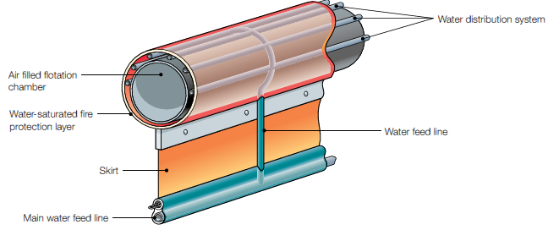
Actively Cooled Fire Boom
Source: IPIECA/IOGP
CGPRT(W) : Ensuring Clean Seas and Coasts in Western Region ……

Slide 19
Intrinsically Fire-Resistant Boom
Relies upon fire-resistant materials to maintain integrity.
Do not require support systems thus simplifying maintenance and deployment.
Shipped in containers or on pallets.
Deployment and retrieval will rely on manpower and vessel crane, if available.
CGPRT(W) : Ensuring Clean Seas and Coasts in Western Region ……

Slide 20
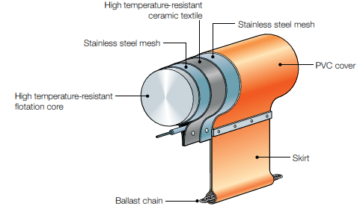
Intrinsically Fire-Resistant Boom
Source: IPIECA/IOGP
CGPRT(W) : Ensuring Clean Seas and Coasts in Western Region ……

Slide 21
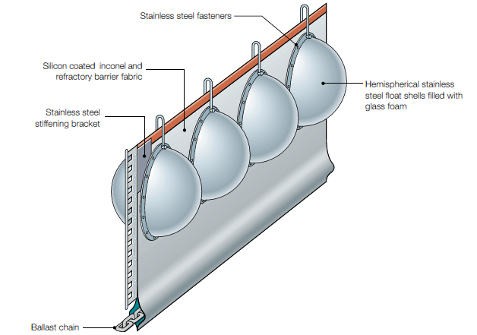
Intrinsically Fire-Resistant Boom
Source: IPIECA/IOGP
CGPRT(W) : Ensuring Clean Seas and Coasts in Western Region ……

Slide 22
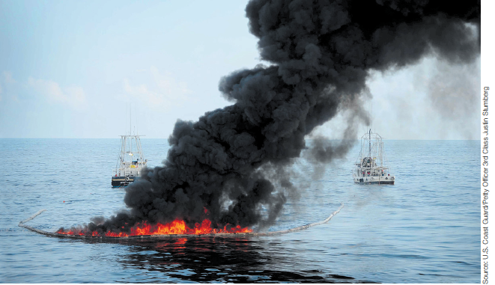
ISB in Operation
Source: IPIECA/IOGP
CGPRT(W) : Ensuring Clean Seas and Coasts in Western Region ……

Slide 23
Igniters
The ease with which ignition will be reached depends on:
  The concentration of hydrocarbon vapours
  The oil type (flash point and auto-ignition temperature)
  The amount of weathering
  The ability of an igniter to provide a source of heat for sufficient time to heat the vapours and bring them to ignition.
CGPRT(W) : Ensuring Clean Seas and Coasts in Western Region ……

Slide 24
Safe Distance Calculations
Type and Area | Burn Area (Acres) | Safe Distance (km) | Safe distance (miles)
Crude Oil Burns
Small Area (250 m³) | 0.6 | 0.09 | 0.06
Medium Area (500 m³) | 1.2 | 0.5 | 0.3
Large Area (750 m³) | 1.9 | 3.2 | 2
Diesel Burns
Small Area (250 m³) | 0.6 | 0.8 | 0.5
Large Area (500 m³) | 1.2 | 20 | 12.4
CGPRT(W) : Ensuring Clean Seas and Coasts in Western Region ……

Slide 25
Air Quality Monitoring
If this technique is to be considered then air quality monitoring needs to be put into place.
On site monitoring is required for hazardous and flammable/explosion conditions.
Down-wind monitoring is required for public health concerns.
On-going weather monitoring and forecasting should be in place.
CGPRT(W) : Ensuring Clean Seas and Coasts in Western Region ……

Slide 26
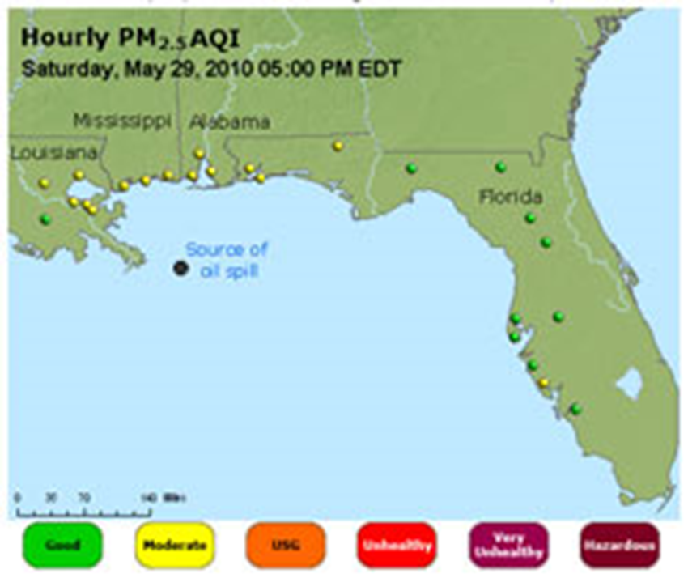
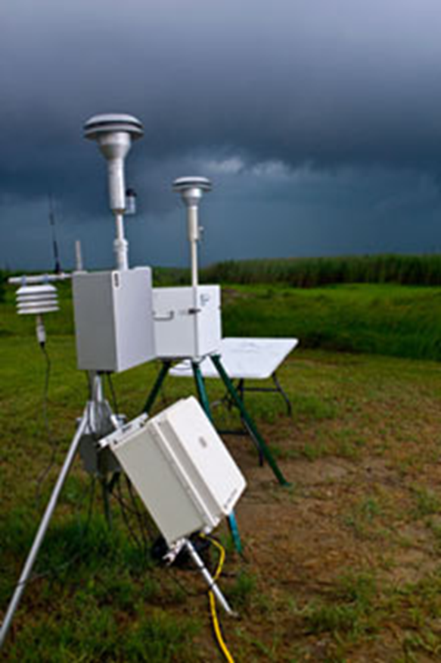
Air Quality Monitoring
Source: US EPA
CGPRT(W) : Ensuring Clean Seas and Coasts in Western Region ……

Slide 27
ISB - NEBA
Advantages | Disadvantages
Can, under the right conditions and with the right equipment, quickly remove large amounts of oil | Ignition of weathered or emulsified oil can be difficult
Can lessen recovery time and disposal chain for oily wastes | Generates smoke and soot
Once ignited, most oils will burn | Has inherent, but manageable, safety risks
Can be used in any water environment (marine, estuarine, freshwater) | Some residues can sink
Can be carried out at night | Fire booms required for burning of freshwater and marine oil spills are large pieces of equipment that are a challenge to rapidly transport
Source: ExxonMobil Oil Spill Response Field Manual
CGPRT(W) : Ensuring Clean Seas and Coasts in Western Region ……

Slide 28
Conclusion
ISB may be a response option but depends on a number of key factors:
  The oil type
  The amount of weathering that has taken place
  The current and forecasted weather conditions
  The availability of equipment
  The ability to carry out the operation safely
  The safety of the responders and public
  NEBA considerations during planning phase
CGPRT(W) : Ensuring Clean Seas and Coasts in Western Region ……

Slide 29
Any questions?
CGPRT(W) : Ensuring Clean Seas and Coasts in Western Region ……

